Slide 1
Effects of Cigarette Smoking
How Smoking affects Breathing

Slide 2
Introduction
Smoking affects the respiratory system by damaging airways and small air sacs.
Most of lung cancer is caused by cigarette smoking
The containment of carbon monoxide and nicotine usually prevent breathing hence contributing to secondary diseases.
Notes:
Smoking affects the respiratory system by damaging airways and small air sacs. It is evident that short term effects of smoking leads to shortness of breath and other factors that have a negative influence on individuals inhalation. Most of lung cancer is caused by cigarette smoking. Even the introduction of electronic smoking is harmful to the lungs as they become more infected by the dangerous chemical substances contained in a smoke. The increased usage of nicotine addiction and also other elements is a major factor that affects individuals hence creating to harmful chemical substances that affect individuals.
The containment of carbon monoxide and nicotine usually prevent breathing hence contributing to secondary diseases

Slide 3
How Breathing works
Breathing works through ventilation
Pulmonary Gas exchange
Transport of gas
Peripheral gas exchange
Notes:
When an individual breaths in, their diaphragm usually contracts and also moves downwards. In most cases, through a process of ventilation, the ventilation system helps individuals to breath in oxygen while breathing out the carbon dioxide. The pulmonary gas exchange usually takes place through a process of diffusion and in most cases it depends on the pressure gradient. This breathing in process usually helps individuals to transport gas into the alveoli so that it can be exchanged outside.

Slide 4
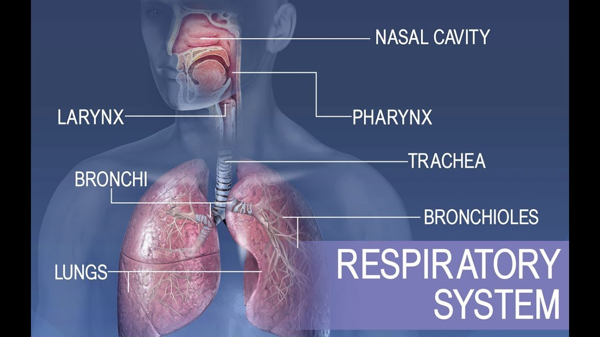
Anatomy respiration
Notes:
This is the anatomy of the respiration system. Gas usually enters the body through the nasal cavity down to the lungs. However, it passes down through the pharynx, the larynx, the trachea or the windpipe to the bronchioles. When one smokes, it is evident that the bronchioles and the lungs as a system are affected by the increased consumption of harmful gas substances.

Slide 5
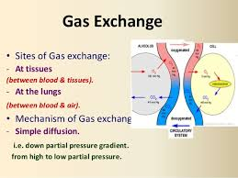
Physiology of gas Exchange
Notes:
The above image depicts the physiology of the gas exchange system in the body. When an individual smokes, it is evident that the small tissues in the lungs are the ones that become damaged while the mechanism for gas exchange such as diffusion becomes also damaged as a result. This process usually affects how individuals consume their gas substances hence affecting them overall.

Slide 6
Dangers of E-Cigarettes
E-cigarettes contain volatile compounds that are cancer causing agents
Heavy metals such as nickel, iron and lead have been found in e-cigarettes
Ultrafine particles have also been found
Notes:
E-cigarettes contain volatile compounds that are cancer causing agents. This makes e-cigarettes as dangerous as other chemical compounds hence cannot be justified as they can cause harm similar to other compounds. In addition, heavy metals such as nickel, iron and lead have been found in e-cigarettes. In addition, ultrafine particles have also been found in these cigarettes hence making them dangerous chemical substances.

Slide 7
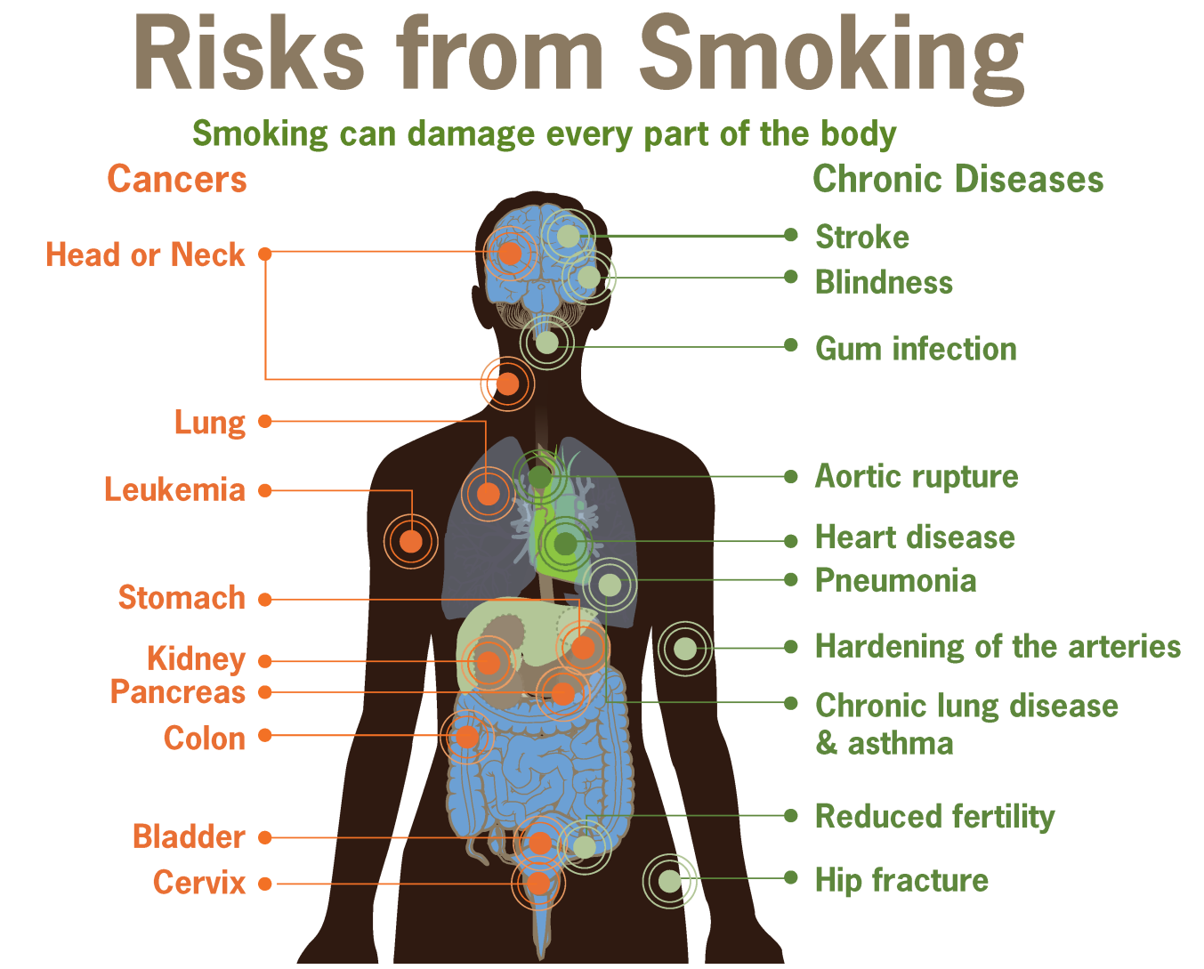
Risks form smoking
Notes:
There are many chronic diseases that are associated with cigarrette smoking. These range from stroke, aortic rupture, pneumonia, hip fracture and also reduced fertility. Behavioral factors are also associated with cancer development. For instance smoking is seen as one of the largest risks for cancer in the world Mostly its related to causing death through lung cancer though other cancers such as the pancreas, urinary bladder, trachea ,kidney and oral cavity among others.

Slide 8
Stroke
Stroke is a major cardiovascular disease associated with smoking
When carbon and nicotine enter the blood stream they are always affected which prevents them from having a faster heart beat
The nicotine and carbon usually affect the system, which leads to high blood pressure that affects the system.
Notes:
Stroke is a major cardiovascular disease associated with smoking. Stroke usually occurs in the cases where there has been an interruption of the blood supply to the brain preventing vital nutrients and oxygen from entering into the brain. This usually affects how an individual breaths and has a major impact to the overall body. When carbon and nicotine enter the blood stream they are always affected which prevents them from having a faster heart beat. The nicotine and carbon usually affect the system, which leads to high blood pressure that affects the system.

Slide 9
Smokeless Tobacco products
Most of the smokeless tobacco products lead to the development of orophryngeal cancer.
Respiratory diseases such as emphysema have been associated with the use of these substances.
Sharing these smokeless tobacco products can transfer many viruses and also bacteria infections.
Notes:
Most of the smokeless tobacco products lead to the development of orophryngeal cancer.
Respiratory diseases such as emphysema have been associated with the use of these substances.
Sharing these smokeless tobacco products can transfer many viruses and also bacteria infections.

Slide 10
Conclusion
To sum it up, smoking is dangerous as it leads to inflammation and also reduced immunity
Smoking has been found to be a major cause of diabetes mellitus.
E-smoking is as dangerous because it also contains chemical substances that also affect the lungs.
Notes:
To sum it up, smoking is dangerous as it leads to inflammation and also reduced immunity. Besides there are many diseases that are caused by e smoking which makes it more dangerous as compared to other chemical substances. There is a need to establish measures that would reduce any harmful smoking that might cause danger to an individual. Smoking has been found to be a major cause of diabetes mellitus.
E-smoking is as dangerous because it also contains chemical substances that also affect the lungs.

Slide 11
References
Walker, J. M. (2005). Implementing an electronic health record system. London: Springer
Thorpe, G. L., & Olson, S. L. (1997). Behavior therapy: Concepts, procedures and applications. Boston ; Toronto: Allyn and Bacon.
Brannon, L., & Feist, J. (2010). Health psychology: An introduction to behavior and health. Australia: Wadsworth, Cengage Learning.

